Slide 1
Sequential circuits
FE BTech CSBS - PEE

Slide 2
Difference between combinational and sequential circuits
Logic circuits for digital systems may be combinational or sequential.
A combinational circuit consists of logic gates whose outputs at any time are determined from only the present combination of inputs. A combinational circuit performs an operation that can be specified logically by a set of Boolean functions.
In contrast, sequential circuits employ storage elements in addition to logic gates. Their outputs are a function of the inputs and the state of the storage elements. Because the state of the storage elements is a function of previous inputs, the outputs of a sequential circuit depend not only on present values of inputs, but also on past inputs, and the circuit behavior must be specified by a time sequence of inputs and internal states

Slide 3
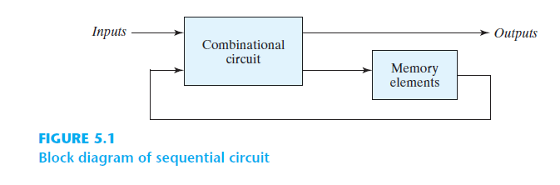
A sequential circuit is specified by a time sequence of inputs, outputs, and internal states .

Slide 4
Synchronous Vs Asynchronous Sequential Circuits
Synchronous | Asynchronous
A synchronous sequential circuit is a system whose behavior can be defined from the knowledge of its signals at discrete instants of time. | The behavior of an asynchronous sequential circuit depends upon the input signals at any instant of time and the order in which the inputs change.

Slide 5
Synchronous Vs Asynchronous Sequential Circuits
Synchronous | Asynchronous
A synchronous sequential circuit employs signals that affect the storage elements at only discrete instants of time such as a clock signal having the form of a periodic train of clock pulses. | In gate-type asynchronous systems, the storage elements consist of logic gates whose propagation delay provides the required storage. Thus, an asynchronous sequential circuit may be regarded as a combinational circuit with feedback.

Slide 6

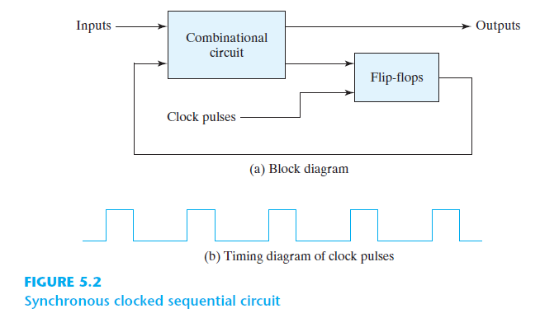

Slide 7
A storage element in a digital circuit can maintain a binary state indefinitely (as long as power is delivered to the circuit), until directed by an input signal to switch states.
Storage elements are of two types:
Latches | Flip-flops
Latches operate with signal levels (rather than signal transitions) | FFs are controlled by a clock transition
Latches are level sensitive devices | FFs are edge-sensitive devices.
Latches are made up of gates | FFs are made up of clocked latches
Not much practical use; only known use is in switch debouncing circuits | Widely used as memory elements and components of sequential circuits

Slide 8
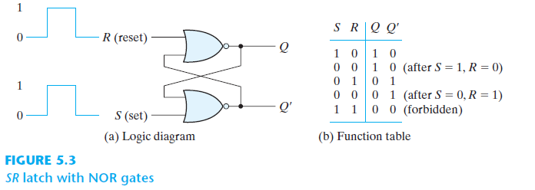

Slide 9
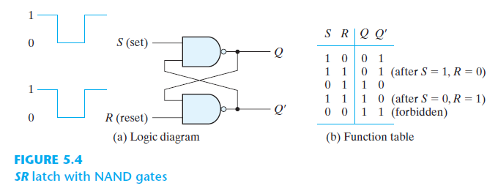

Slide 10
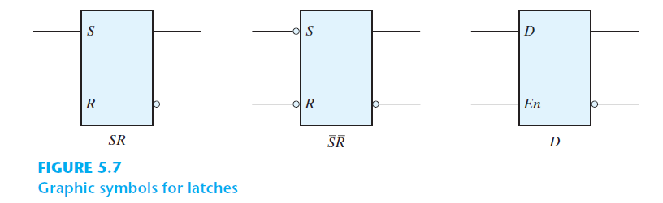

Slide 11
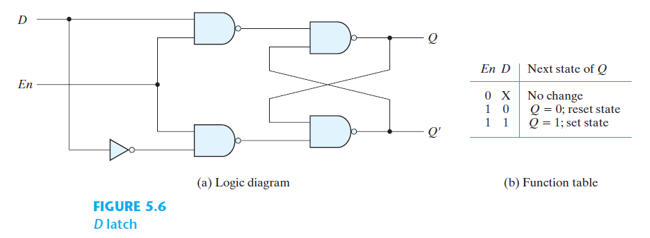

Slide 12

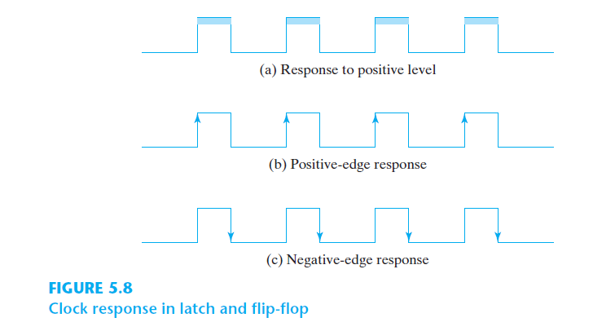

Slide 13
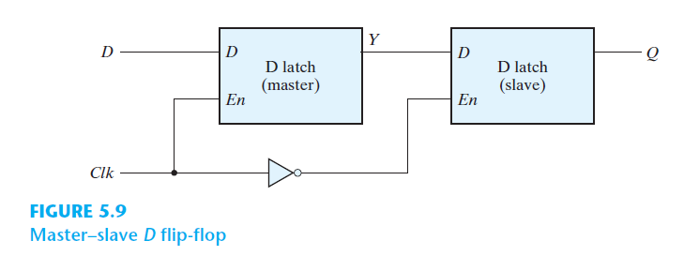

Slide 14
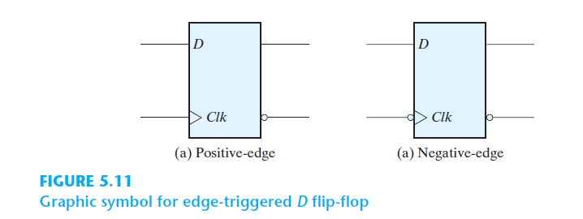

Slide 15
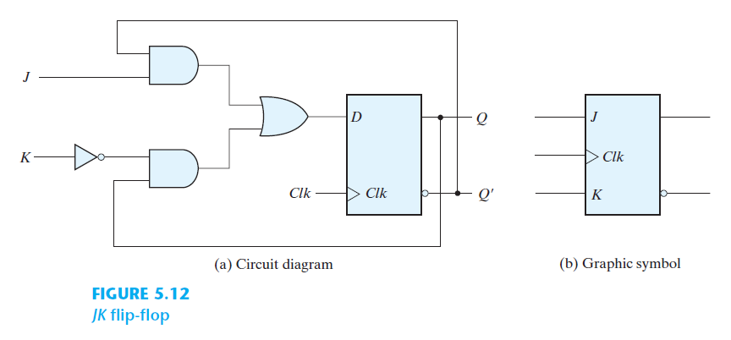
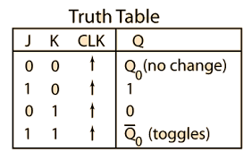

Slide 16
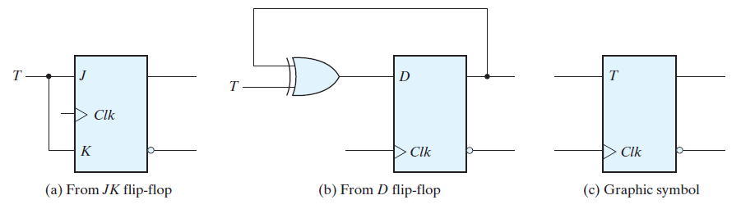
T-Flip Flop – needed to construct counters
T | Present state Op Q(t) | Clock | Next state Op Q(t+1)
0 | x | +ve edge | No change
1 | 0 | +ve edge | 1(Toggle)
1 | 1 | +ve edge | 0(Toggle)
x | x | -ve edge | No change

Slide 17
